Slide 1
Team Arm 2024: Code4Fun 2Gether micro:bit
Arm Taiwan Limited

Slide 2
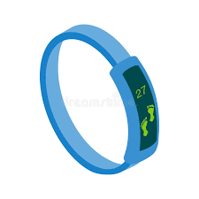


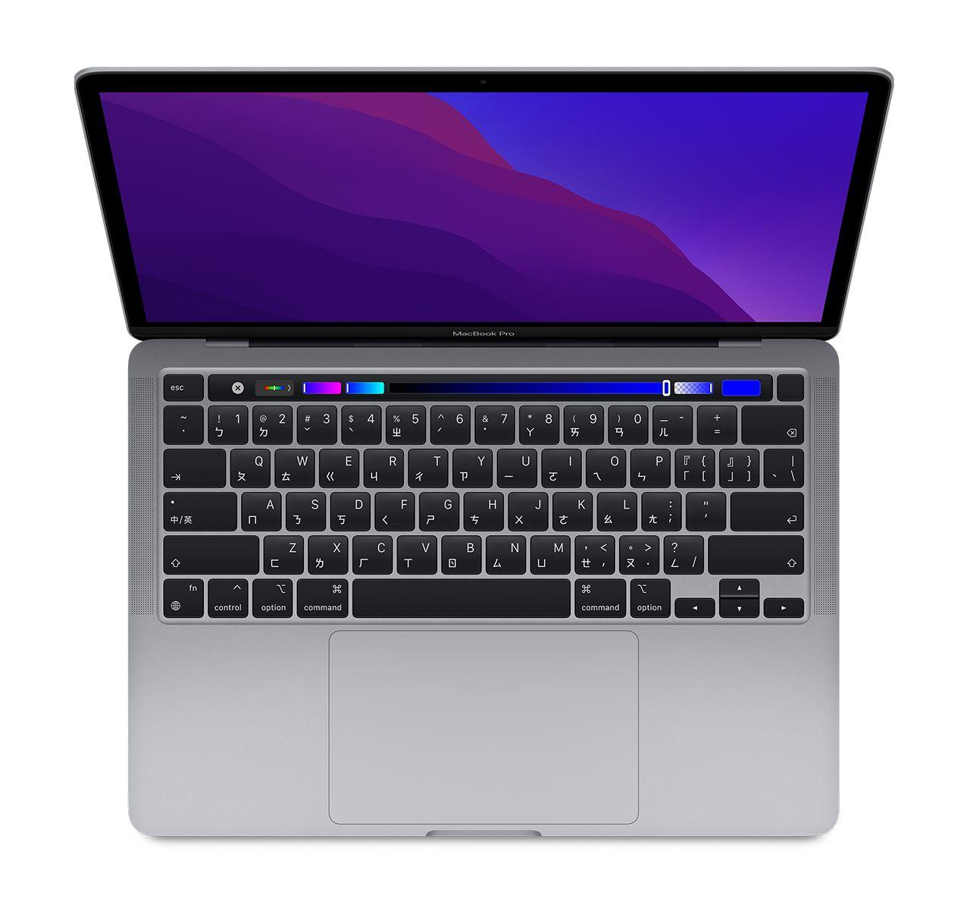


What Are These?

Slide 3
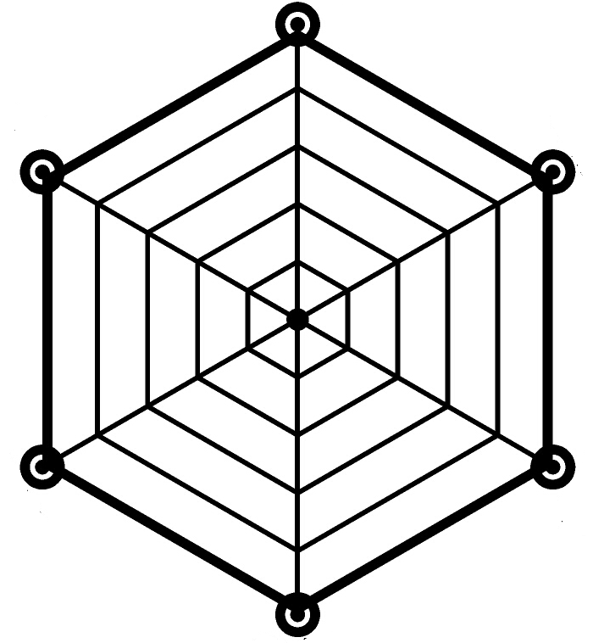
Intelligence (A)
(M) Efficiency
Agility (R)

Slide 4
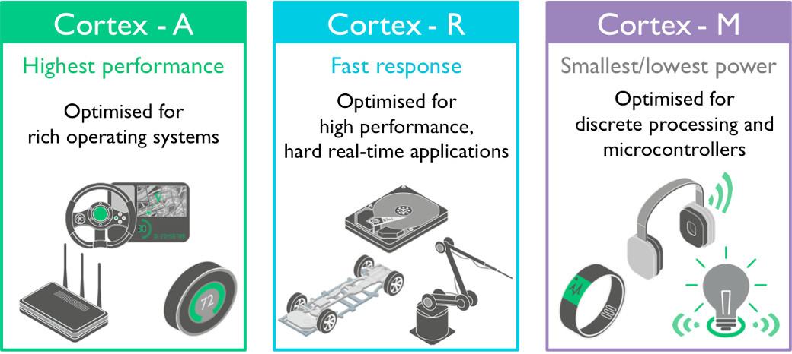
Cortex-A
I am the smartest one.

Slide 5
Cortex-A
Intelligence (A)
(M) Efficiency
Agility (R)

Slide 6
Cortex-R
The Fastest Response

Slide 7
Cortex-R
Intelligence (A)
(M) Efficiency
Agility (R)

Slide 8
Cortex-M
Energy-Efficient

Slide 9
Cortex-M
Intelligence (A)
(M) Efficiency
Agility (R)

Slide 10
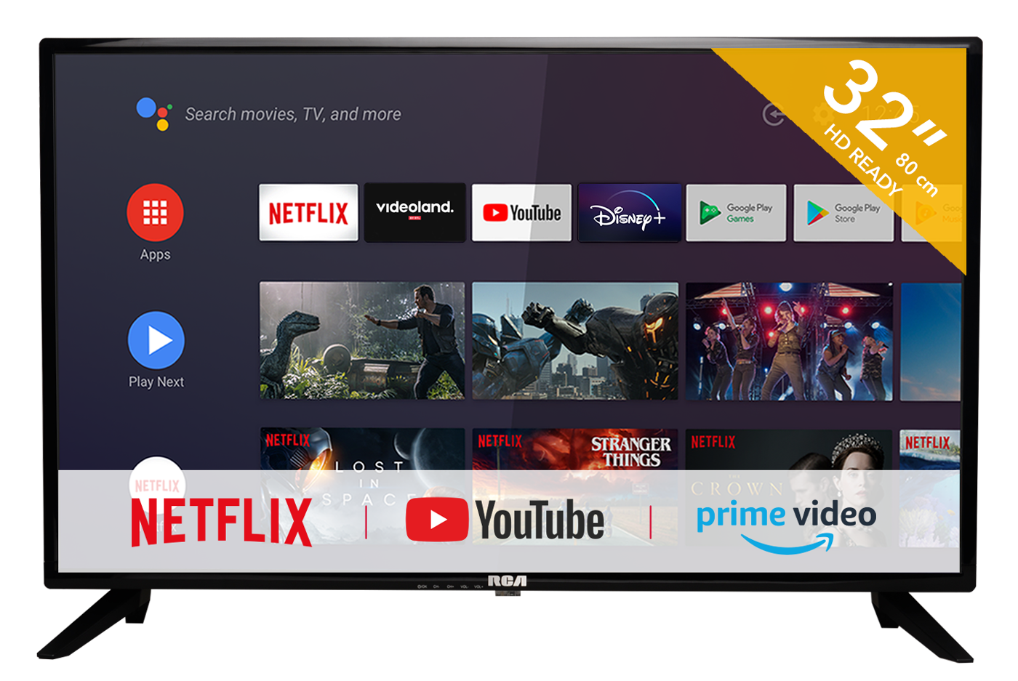
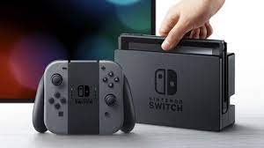
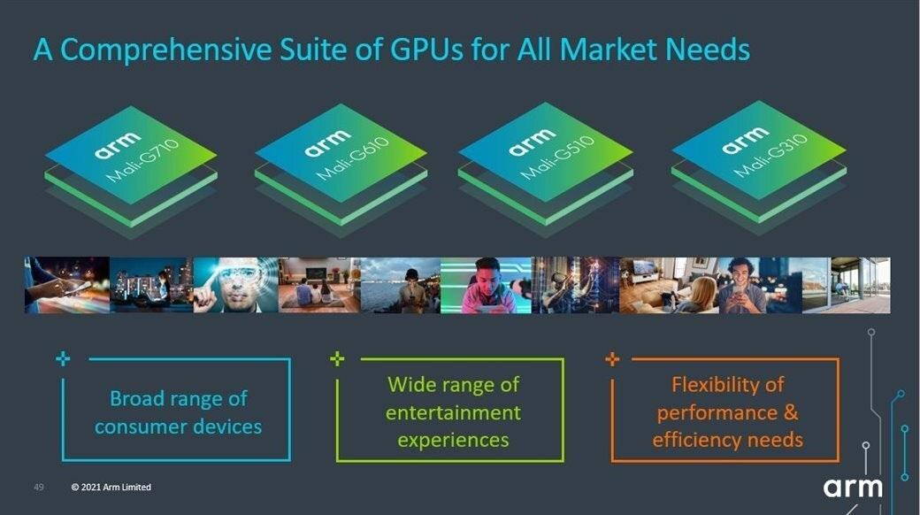
Mali-GPU

Slide 11

Everyone needs Arm

Slide 12
Let’s Give It a Try

Slide 13
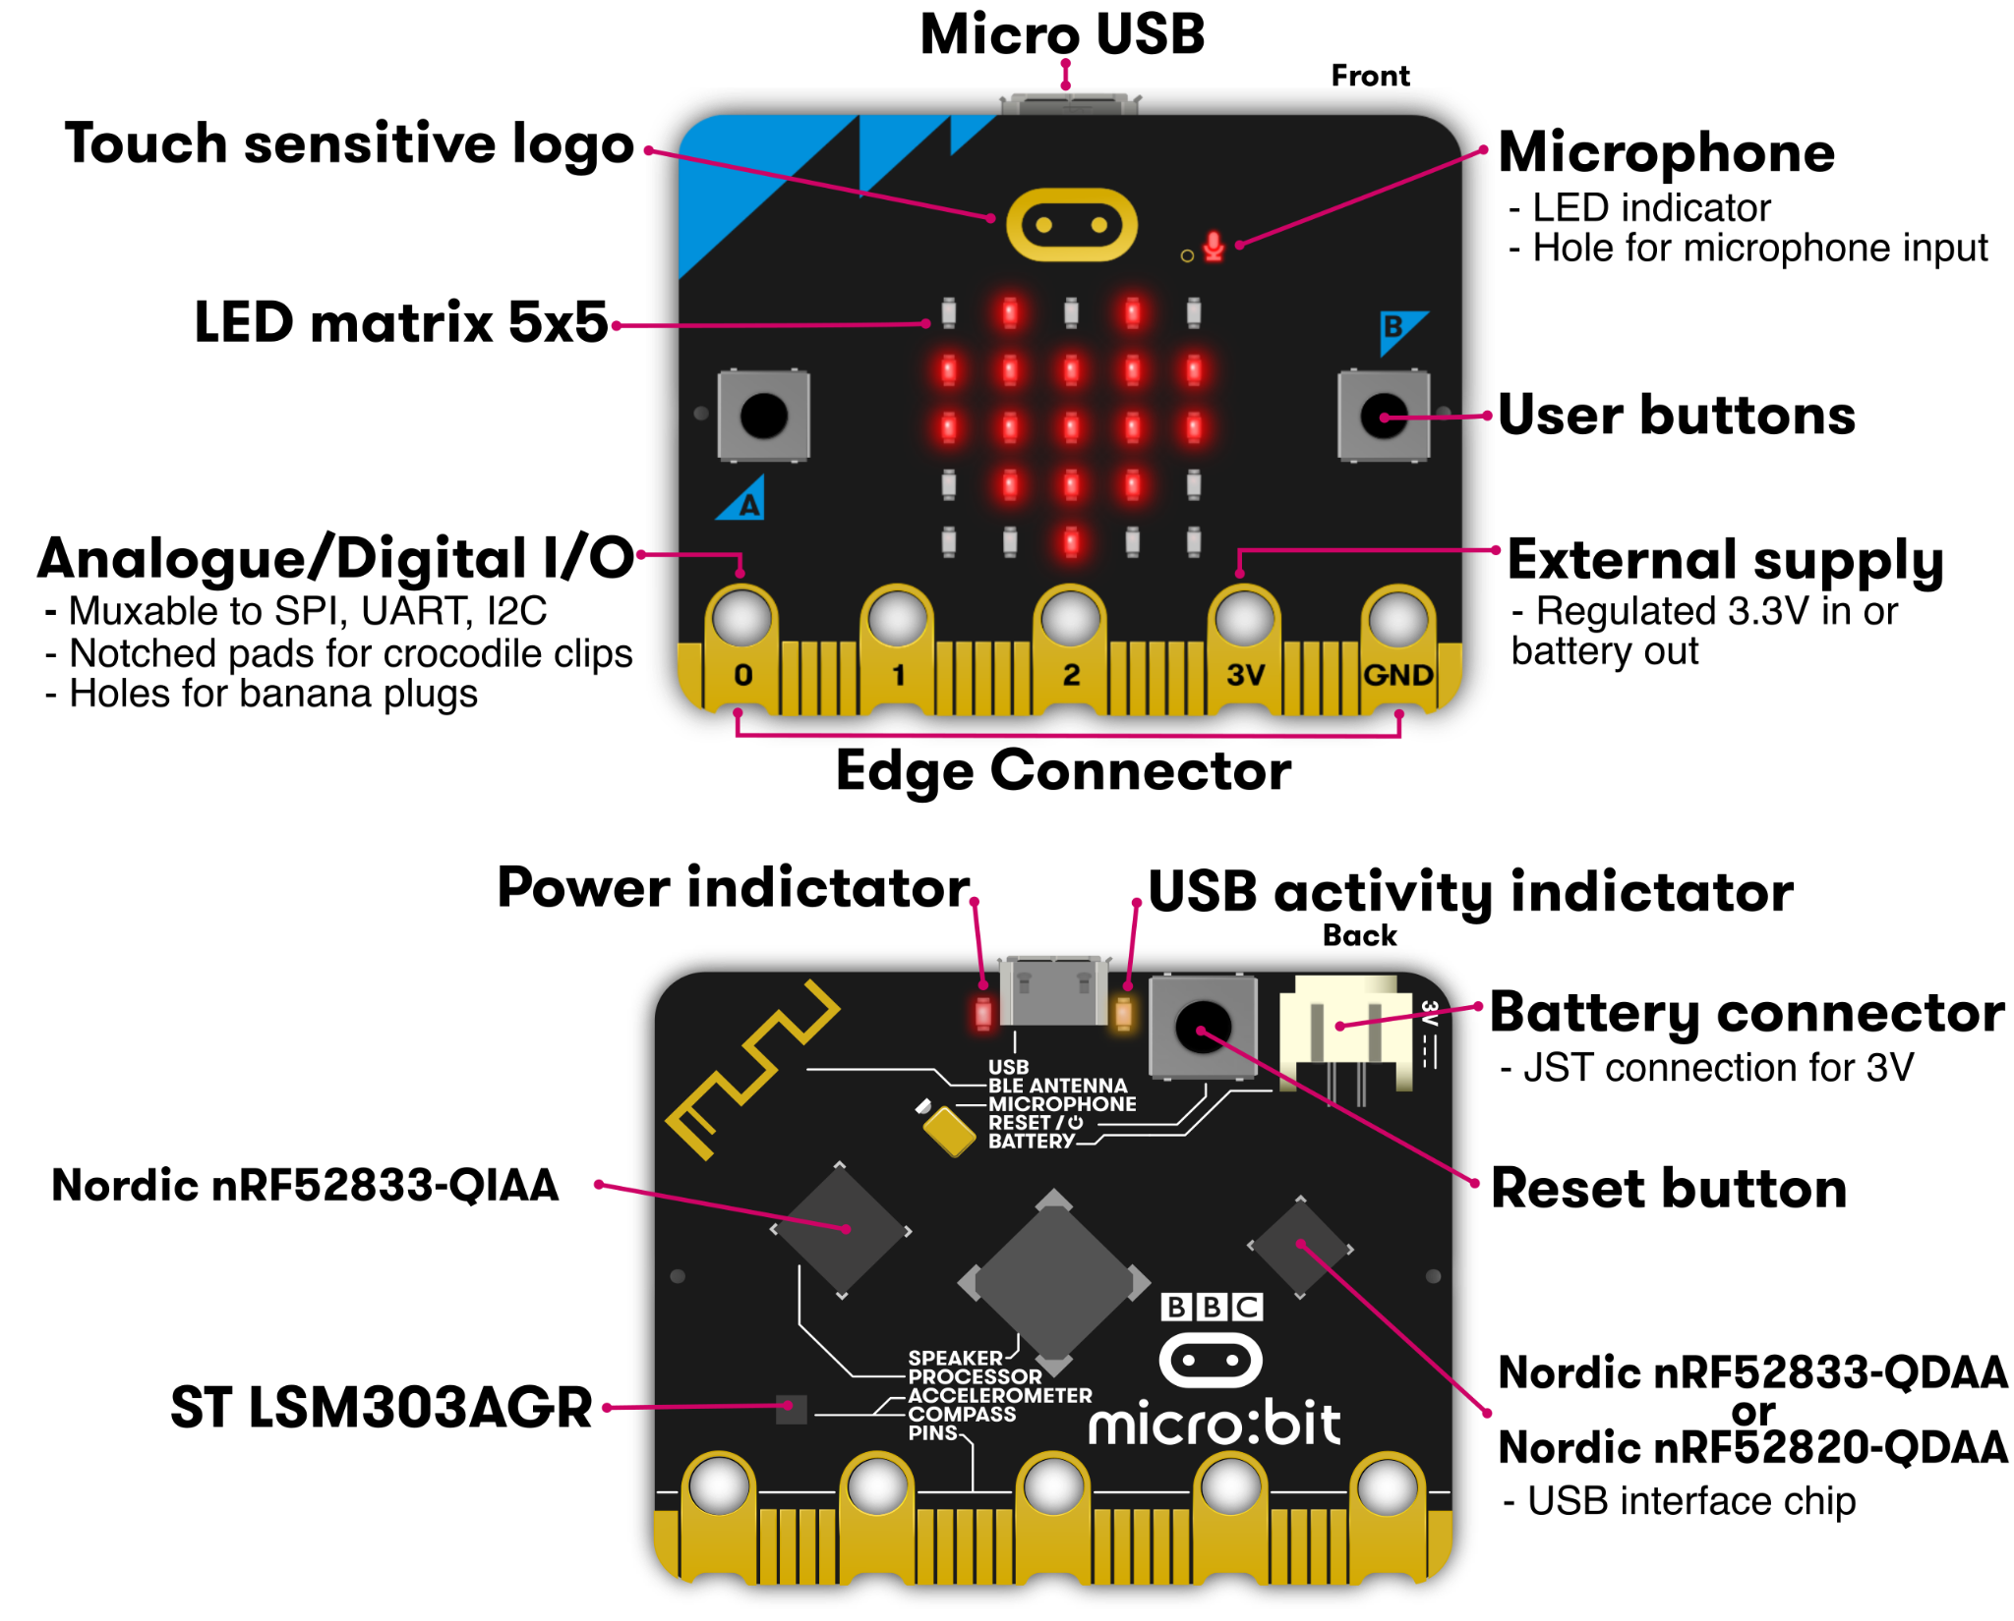
Get to Know More About micro:bit V2
micro usb connector
微型 USB 接口
Power indicator
電源指示燈
USB Activity Indicator
USB 活動指示燈
Radio
Touch logo
Microphone
藍芽及廣播
觸碰感測器標誌
麥克風及指示燈
Battery
電池連接
5 × 5 LED 矩正
光感應可編程 LED 燈
Thermometer
Buttons
溫度計 （CPU 處理器）
Reset/Power Button
重置/電源按鍵
輸入按鍵
外部供電感應
LED lights
GPIO 通用輸入輸出
Compass
指南針／
加速度計
USB Interface Chip
USB 接口芯片
Edge Connector
邊緣連接器
Accelerometer
揚聲器
Speaker
Latest version V2 with multiple sensors：
3-axis accelerometer、temperature、magnetic、microphone、touch LOGO、light、Bluetooth & Radio communication、progammable LED lights and buttons.

Slide 14
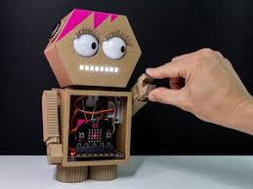
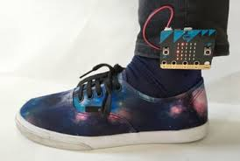
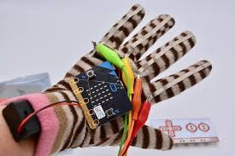
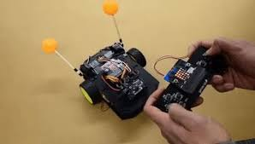
Brainstorming

Slide 15
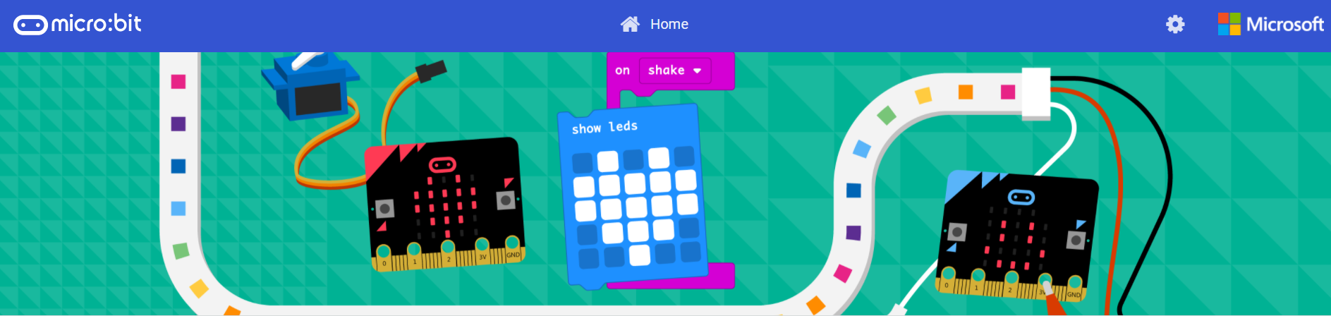
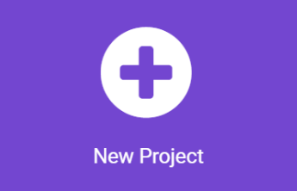
Makecode (makecode.microbit.org)
Microsoft MakeCode is a building block-based programming environment.
Intuitive operation with powerful features allows the micro:bit respond to various inputs and switch to JavaScript and Python, making it in a free platform for learning programming.

Slide 16
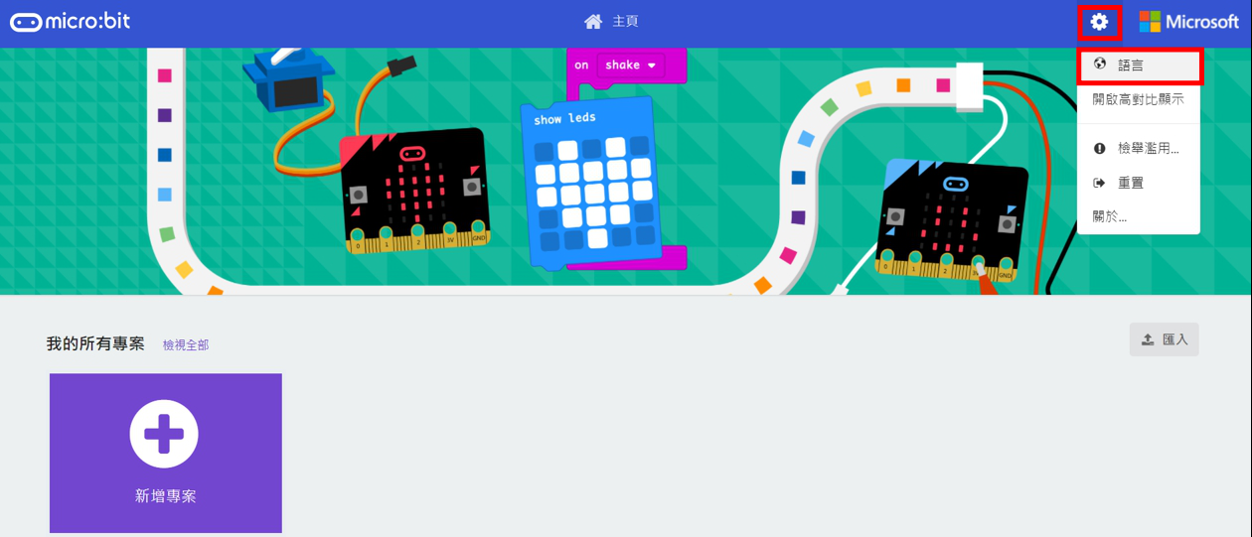
Setting language as English (makecode.microbit.org)
Click the Setting Icon to change language

Slide 17
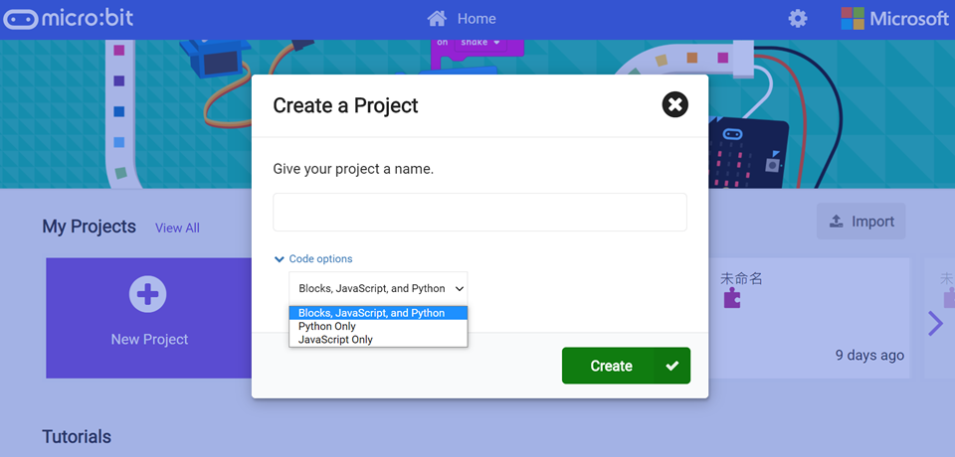
Setting language as English (makecode.microbit.org)
Click the Setting Icon to change language

Slide 18


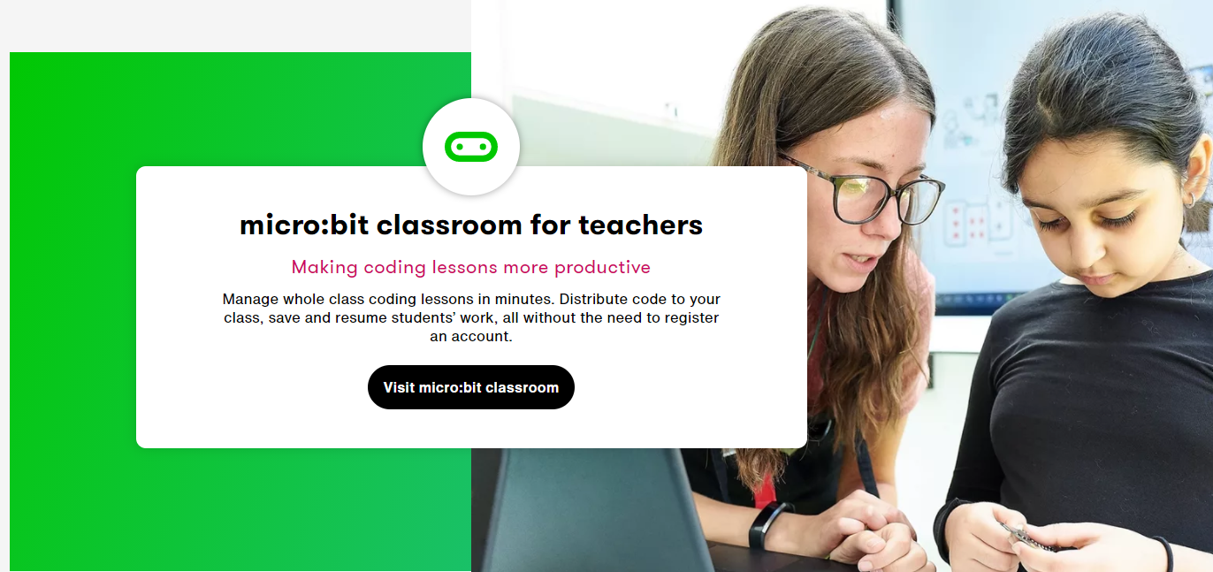
micro:bit Classroom
micro:bit Classroom

Slide 19
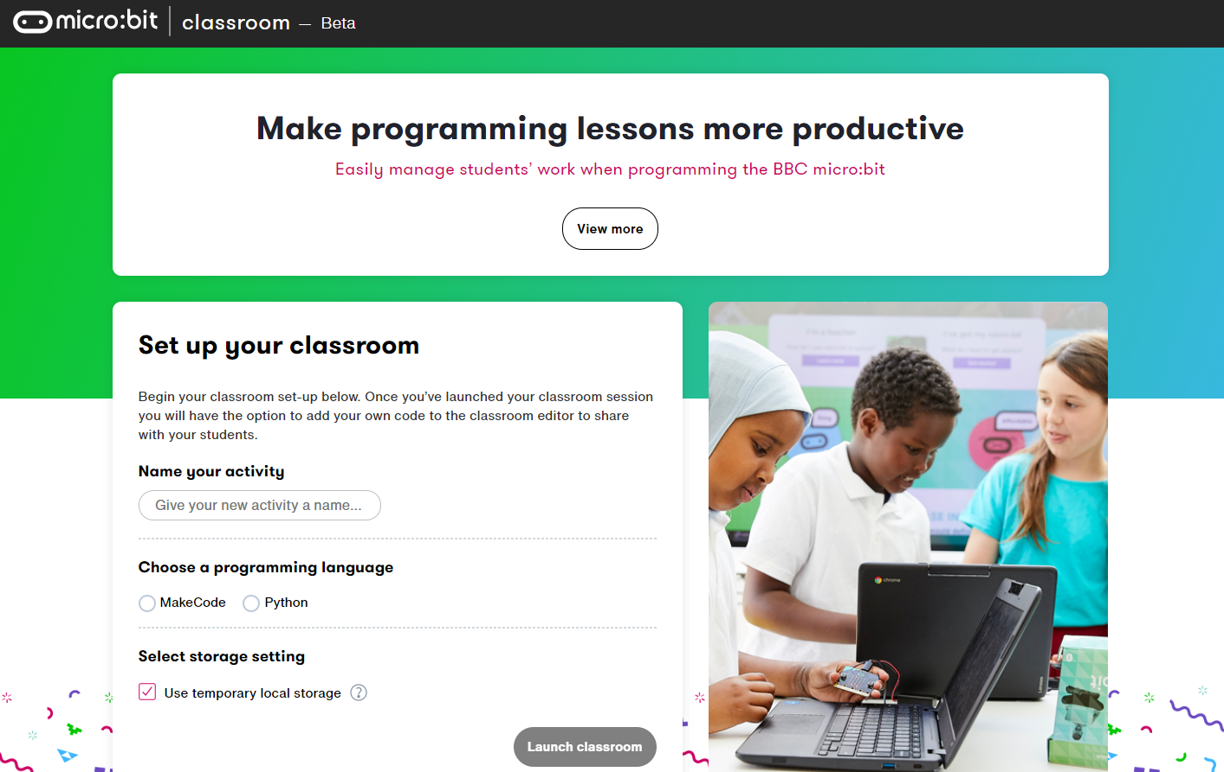
micro:bit Classroom
For teacher to creat a classroom ：https://classroom.microbit.org/

Slide 20
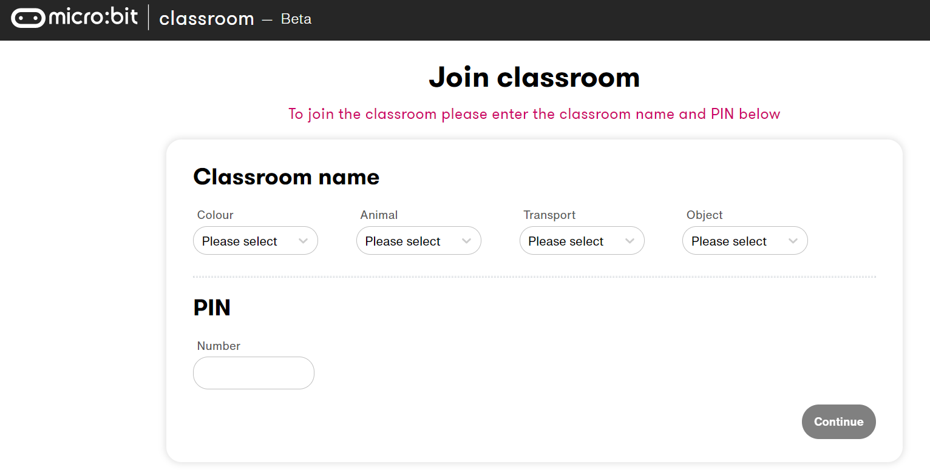
micro:bit Classroom How to join the classroom?
Search https://classroom.microbit.org/joinactivity

Slide 21
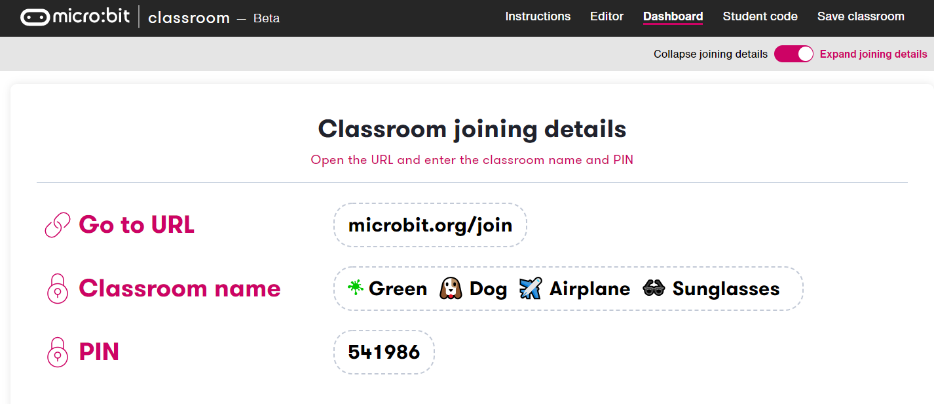
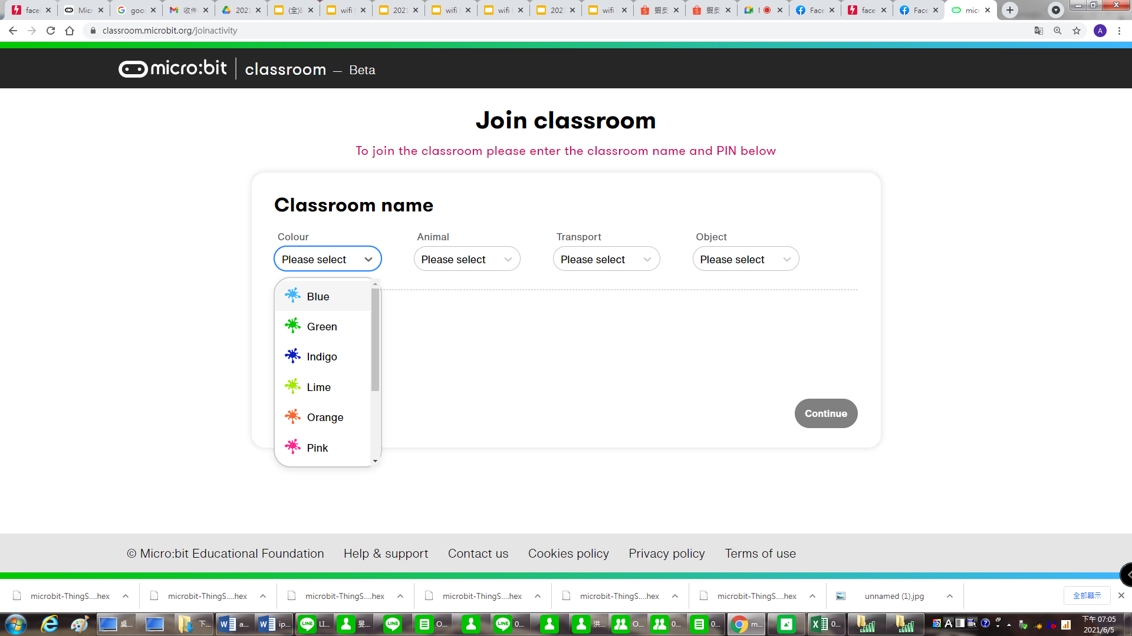
micro:bit Classroom How to type in password
(1) For Teacher : Open the classroom joining details for students
(2) For Student : Choose the same as the teacher’s password (color, animal, transport and object.)
Teacher’s View
Student’s View
※ This is a sample view

Slide 22
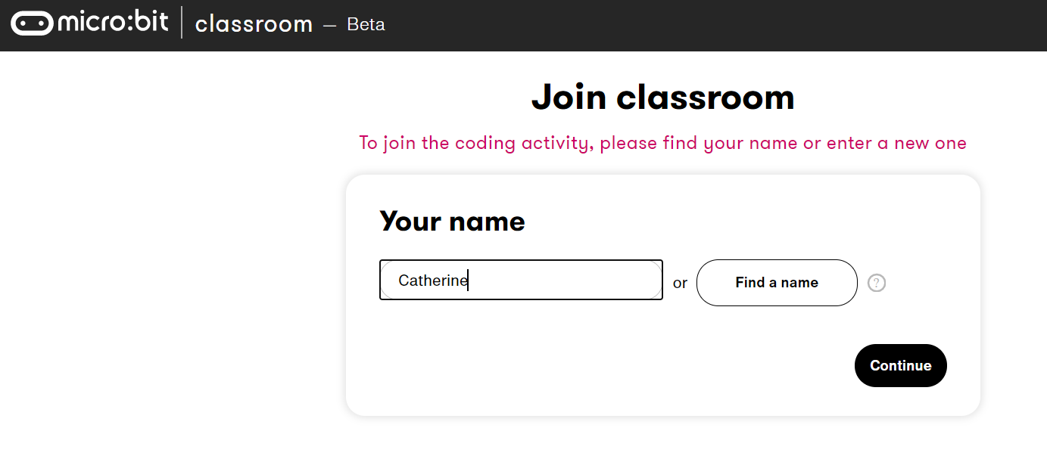
micro:bit Classroom_Type in student’s name (microbit.org/join)

Slide 23
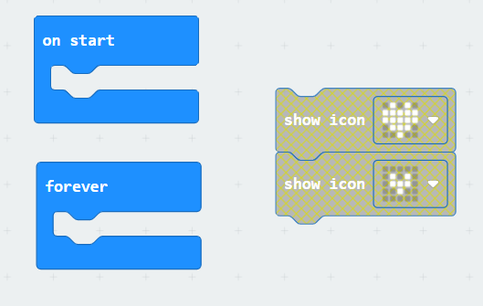
#1【on start】 v.s. 【forever】
microbit-start_forever__1
How to make the heart keeps flashing?

Slide 24
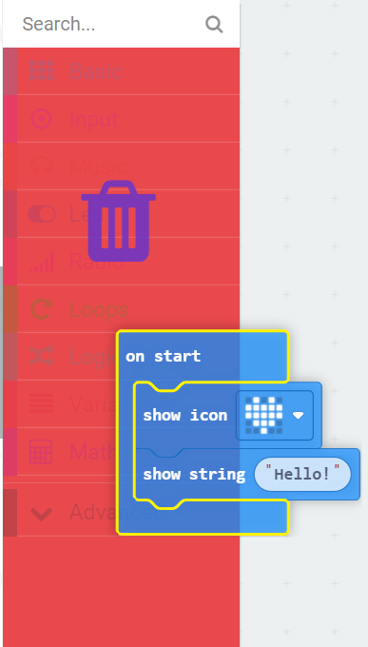

Tips: Makecode Delete and Undo
Delete： ※ Drage the blocks to the menu area，it will show a trach bin icon and then release it.
※Or click the block and press［Delete］button.
Undo： ※Click the left arrow icon ※Keyboard［Ctrl］+［Z］button.

Slide 25
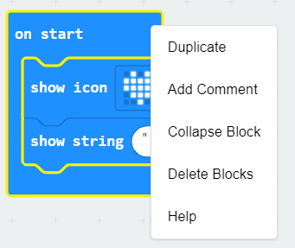

Tips: Makecode_Right-click
※ Mouse pointer on the block and do the right-click
Duplicate：Copy the block
Add Comment：Keep some note for the block
Collapse Block：Shorten the block struture
Delete Blocks：Make the block disappear
Help：Block’s funtions explantaion

Slide 26
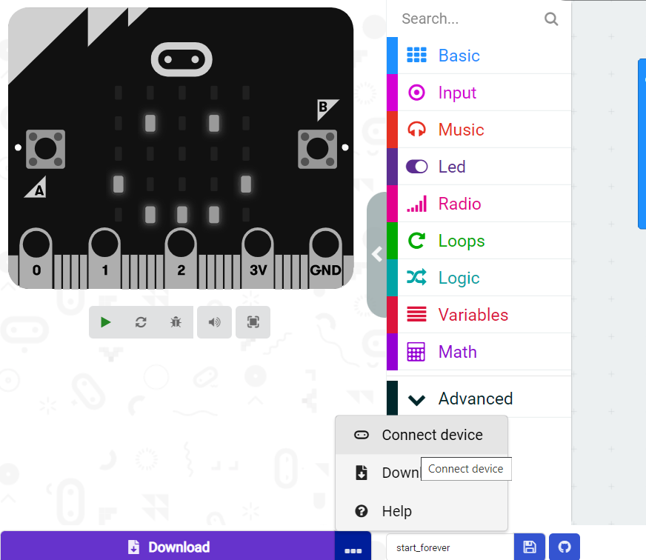
Pair Your micro:bit to The Device
※Click Connect device

Slide 27
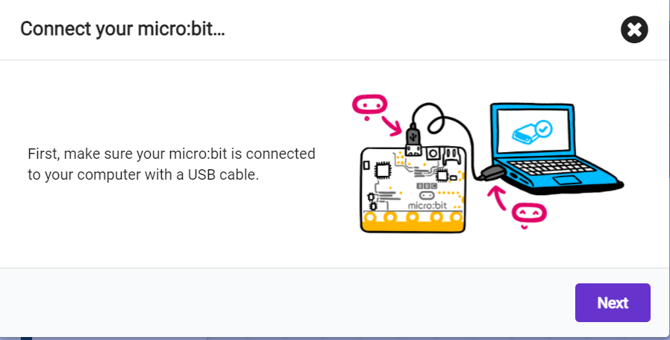
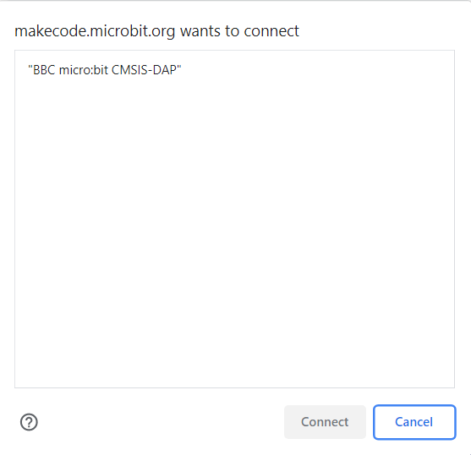
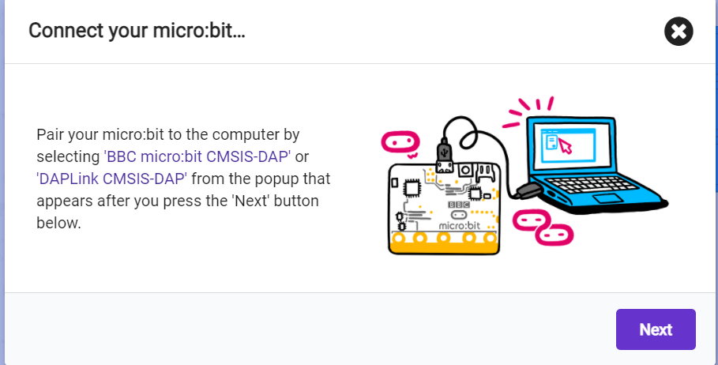
Pair your micro:bit to the device

Slide 28
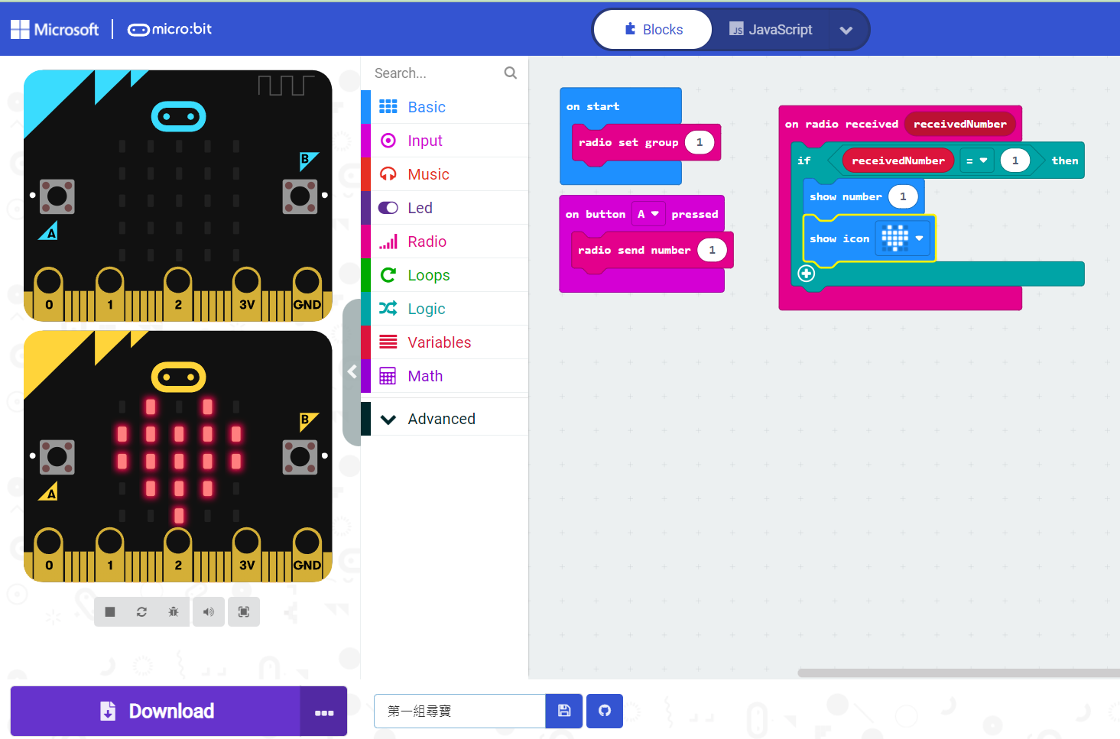
Download the hex file
※ Click the Download button to down the coding file

Slide 29
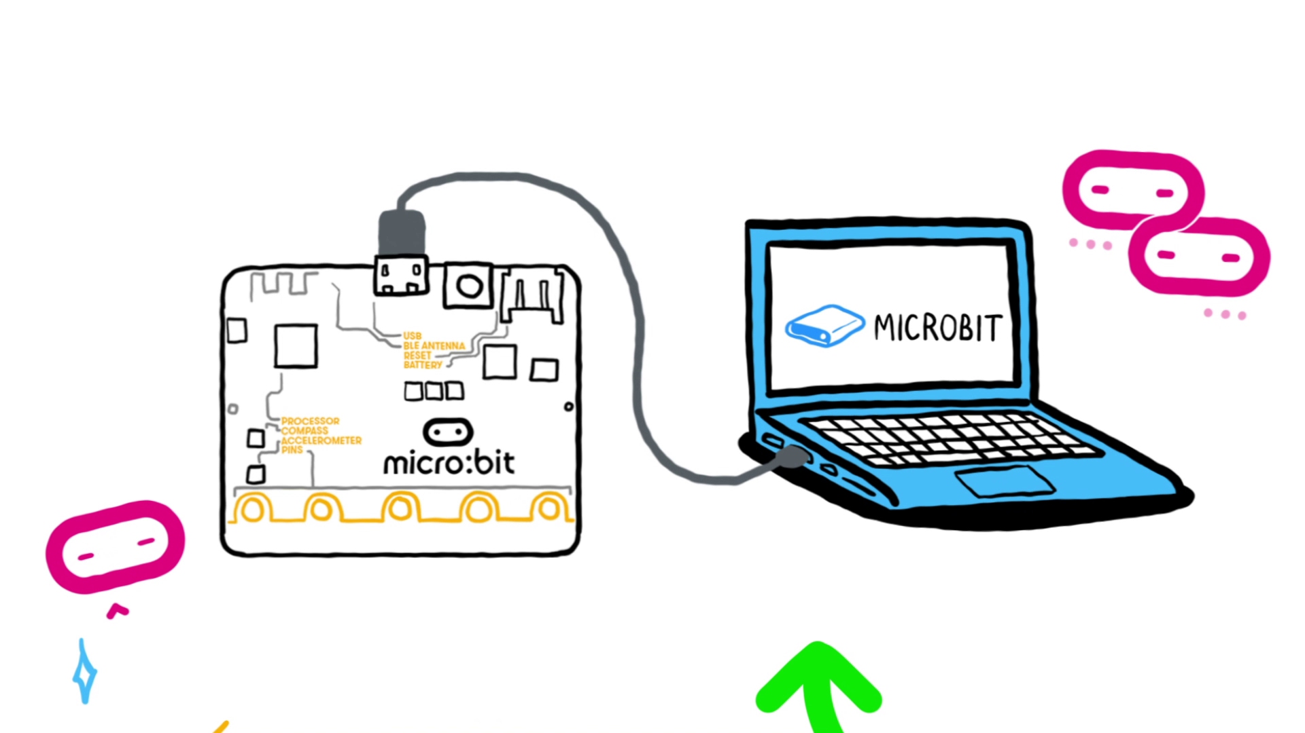
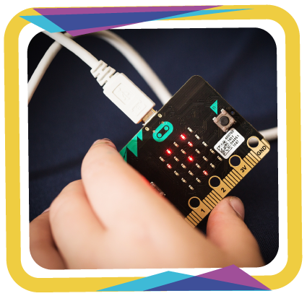
Makecode_How to overwrite microbit’s program?
Step (1) Use USB cable :
One side for micro USB connector (the shorter side)
the other side is for the regular USB input on the computer or laptop (the longer side).
Step (2) Drag the hex file to the microbit storage and release it to overwrite the program.

Slide 30
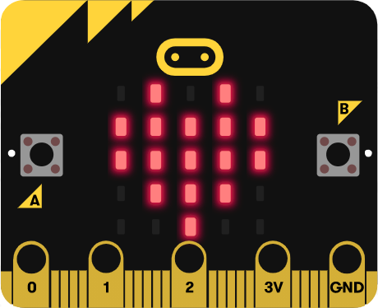
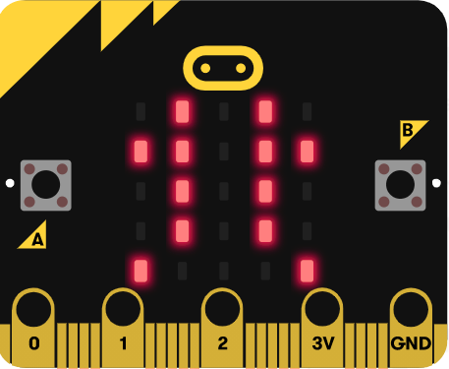
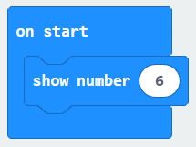
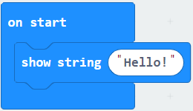
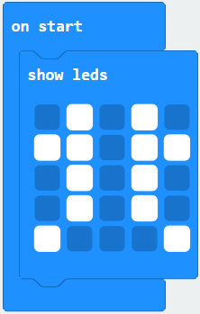
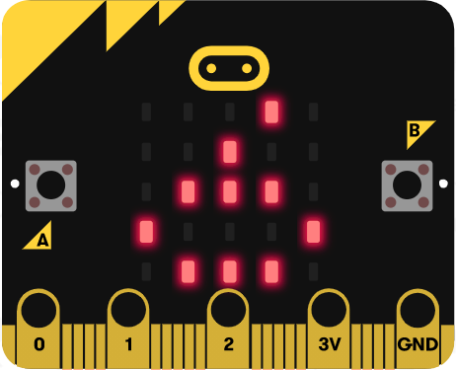
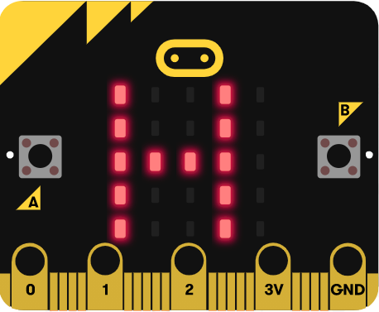
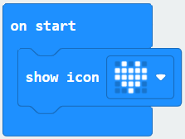
Makecode_【Basic】block
※ it can show : alphabet, number, icon and symbol

Slide 31
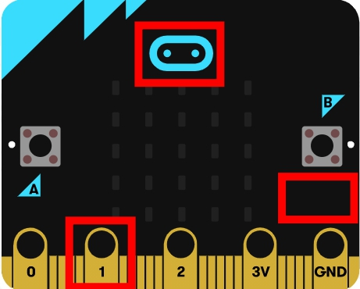
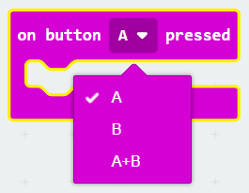
#2 Makecode _ Where are the button?
microbit-press_A_B_AB

Slide 32
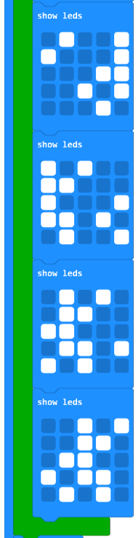
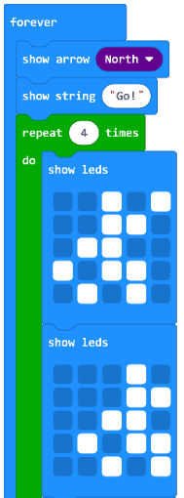
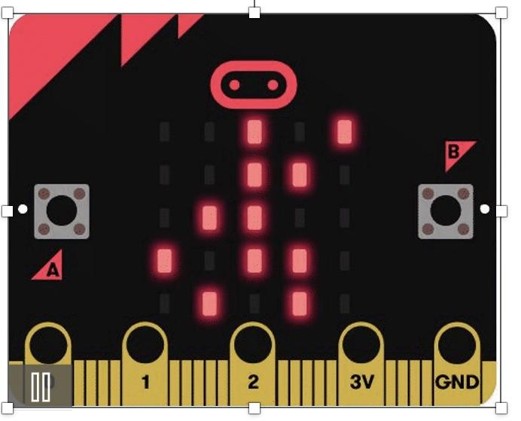
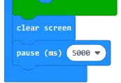
#3 Makecode _ Make it moves

Slide 33
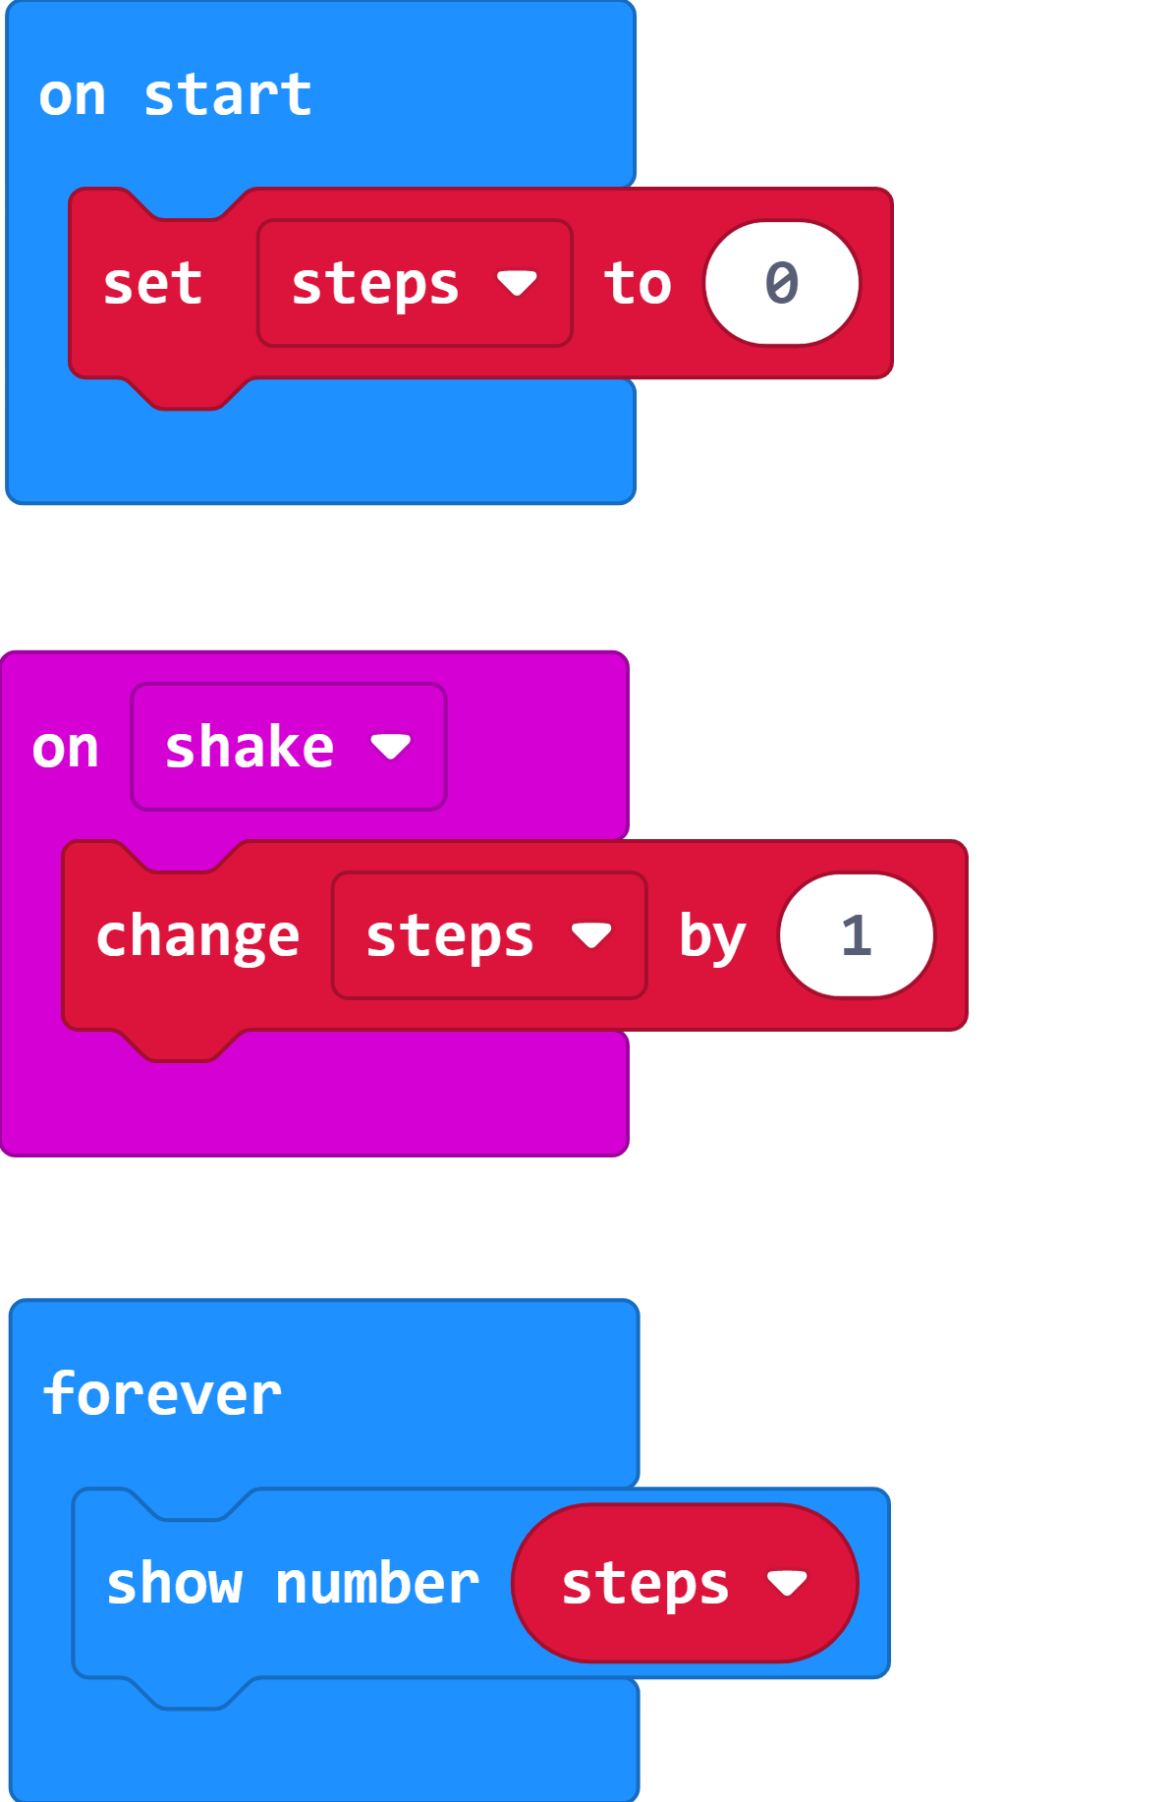
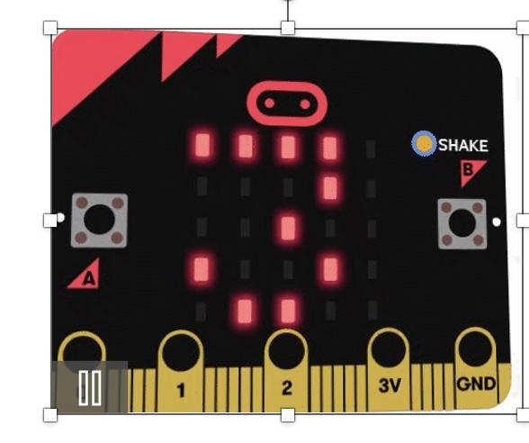
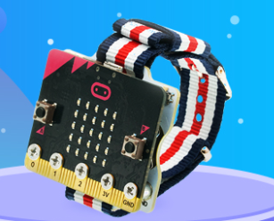
#4 Makecode _ Step Counter

Slide 34
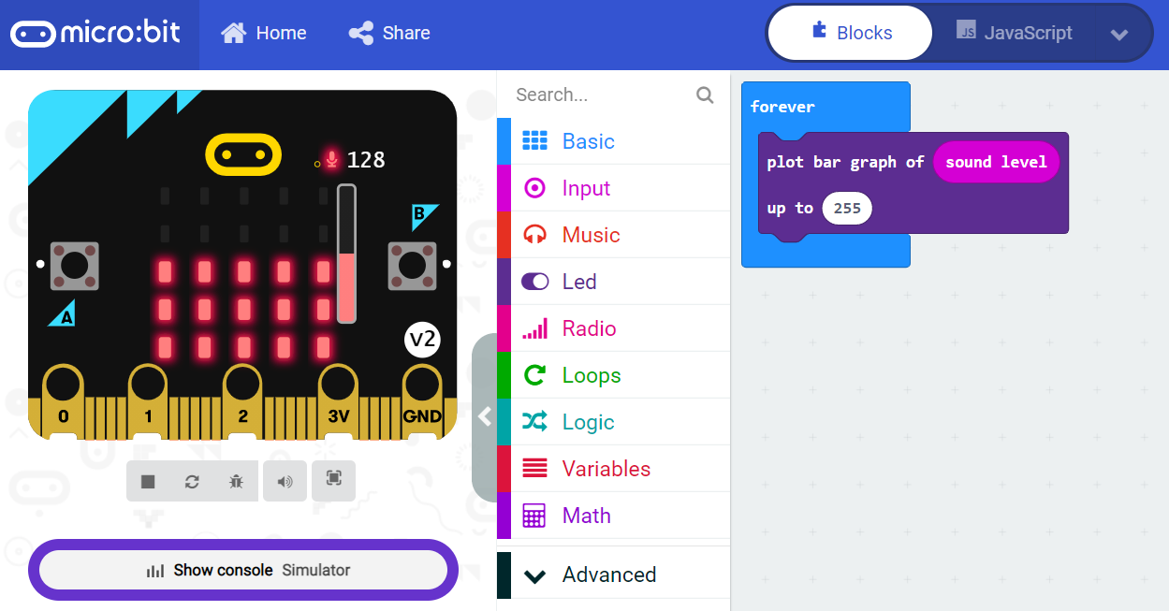
#5 Makecode _ Sound’s Level

Slide 35



#6 Makecode _ Finger-guessing game

Slide 36



Makecode _ Get to know about Music
pitch names
syllable names
sheet music

Slide 37


Makecode _ Make a Music
※ Number represent the sound of frequency
※ pitch names

Slide 38
Makecode _ Free Style of Music
※Low、Middle、High all have a set of CDEFGAB。
低音(Low) 中音(Middle) 高音(High)

Slide 39



#7 Makecode _ Take a guess what melody is it
CDEC 1beat CDEC 1beat EFG 1beat EFG
※ Rest one beat
Notes:
全家超商的進門音樂

Slide 40



#8 Balance challenge

Slide 41


#9 Advanced Lesson

Slide 42



#9 Extensions 【Neopixel】Block

Slide 43


#9 Extensions Neopixel

Slide 44

#9 Extensions Neopixel
※ When pressing the A+B keys, the variable strip is defined as black (=lamp off), so pressing the A or B keys again will not light up the lamp.
You can restart the program with the reset button on the back of the micro:bit to experience it again.
Designed to allow each light bulb to display different colors according to the color sequence of the rainbow,
when pressing the A button, the light bulb will change color 100 times in turn according to the sequence;
press the B button to change the color 100 times in the opposite direction;
press the A+B buttons, then all the light bulbs will go out (display black = turn off the light bulb).

Slide 45

“Writing”
Program?
Notes:
全家超商的進門音樂

Slide 46
Sample
hex | 功能
1__microbit-start_forever | 開始 循環
2__microbit-press_A_B_AB | 按鈕控制
3__microbit-move_move | LED 動畫
4__microbit-step_counter | 計步器
5__microbit-voice_volume | 聲音測量
6__microbit-mora | 剪刀石頭布
7__microbit-melody | 給愛麗絲
8__microbit-acceleration | 平衡器
microbit-collaborative_learning_v11_TreasureChest | 尋寶-寶藏
microbit-collaborative_learning_ver11 | 尋寶器

Slide 47
Sharing Time :
Tell us what you wanna make or what you wanna design?
Notes:
全家超商的進門音樂

Slide 48

Blocks to code
=
from microbit import *
display.scroll("Hello!")

Slide 49
Indentation for formatting
from microbit import *
boat = Image("09090:"
"09090:"
"09090:"
"99999:"
"09990")
display.show(boat)
or
boat = Image("09090:""09090:" "09090:" "99999:" "09990")

Slide 50

Indentation
from microbit import *
while True:
if button_a.is_pressed():
display.show(Image.HAPPY)
elif button_b.is_pressed():
display.show(Image.SAD)
else: display.show(Image.YES)
display.clear()
=

Slide 51
Case sensitivity and special characters
Microbit, microbit and microBit are all different things!
If you get a ‘NameError’ then you have mistyped something.
‘,” and : are all special characters, ensure you haven’t added them by mistake or have missed them where they are needed
Be careful with full stops (.) as these will confuse Python if you use them inappropriately

Slide 52



See you next time~~
Notes:
全家超商的進門音樂

